Slide 1
Proposal for an international standardisation effort in technical validation of photoacoustic imaging
Jeff Bamber¹, Sarah E. Bohndiek², Richard Bouchard³, Kimberly Briggman⁴, Joanna Brunker², Adrien Desjardins⁵, Jeeseong Hwang⁴, James Joseph², Efthymios Maneas⁵, Mark Pagel³, Geoff Parker⁶, Srinath Rajagopal⁷, Wenfeng Xia⁵, Bajram Zeqiri⁷
(1) Institute of Cancer Research, UK; (2) University of Cambridge, UK; (3) MD Anderson Cancer Center, USA; (4) NIST, USA; (5) University College London, UK; (6) University of Manchester, UK; (7) NPL, UK

Slide 2

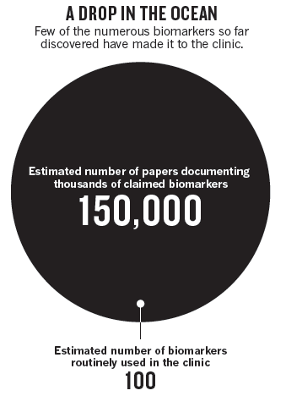
Why should we care about standardisation?
A biomarker is: ‘a defined characteristic that is measured as an indicator of normal biological processes, pathogenic processes or responses to an exposure or intervention, including therapeutic interventions’
Molecular, histologic, radiographic or physiologic characteristics are examples of biomarkers
E.g. total haemoglobin concentration [mM], haemoglobin oxygen saturation (%)
http://www.ncbi.nlm.nih.gov/books/NBK326791; Poste (2011) Nature

Slide 3
The imaging biomarker roadmap provides a pathway for clinical translation of new biomarkers

Slide 4
O’Connor et al (2017) Nat Rev Clin Onc 14 3 169-186

Slide 5
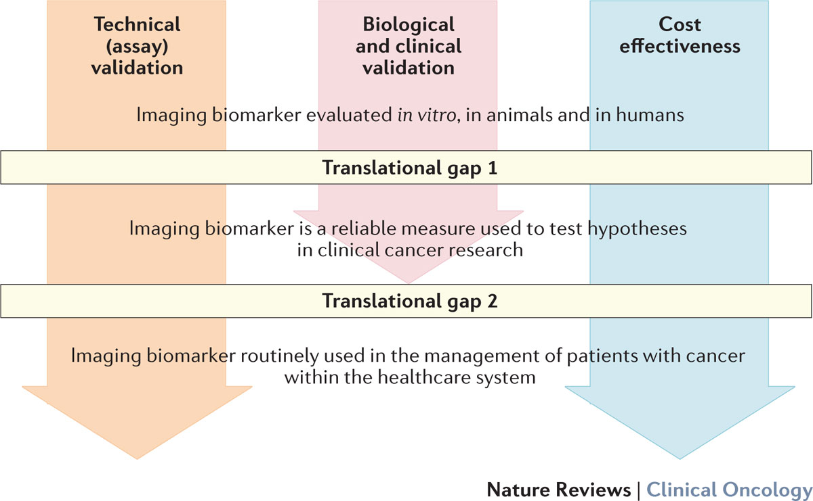
O’Connor et al (2017) Nat Rev Clin Onc 14 3 169-186

Slide 6
To overcome the translational gaps, proper technical validation is needed
Technical Aim: Ensure imaging biomarker workflow is robustly available anywhere it is needed, giving comparable results
Precision: Repeatability (same subject, same scanner, same operator, short interval) and reproducibility (comparable subjects, different scanner make/model, centres).
Accuracy: Faithful recapitulation of the expected signal.
Availability: Including considerations of:
legal/IP impediment;
ethical impediment.
Tolerability: For patients and clinicians.
Doesn’t tell you anything about whether it’s medically or biologically useful!
Notes:
Precision: laser excitation e.g. energy output, acoustic detection e.g. ultrasound coupling, physiology e.g. respiration rate, data handling e.g. image reconstruction method
Accuracy: data handling e.g. image reconstruction method, spectral analysis method
Availability: regulatory approvals of device, licenses for software on remote computers
Model systems: phantoms, mice
Types of measurements: repeated measurements over time (days, weeks, months), repeated measurements in the same subject and in different subjects, across different systems

Slide 7
Biological and clinical validation should be performed in parallel with technical validation
Biology Aim: Ensure imaging biomarker reflects the biology
E.g. therapy-induced change in imaging biomarker faithfully reflects therapy-induced change in underlying pathology.
Clinical Aim: Ensure imaging biomarker forecasts patient outcome
E.g. imaging biomarker (plus clinical status) improves forecast of outcome, compared with forecast based on clinical status alone
Use Bradford Hill criteria where you haven’t (yet) got decent outcome data
Doesn’t tell you whether it’s feasible
Doesn’t tell you whether it’s a cost-effective option!

Slide 8
To perform thorough technical validation studies, well characterised test objects are essential
Materials should ideally be:
Safe to prepare and handle without specialist facilities;
Widely available from commercial chemical vendors, with known within / between batch variation.
Properties of the materials to be considered include:
Optical absorption and scattering;
Speed of sound, acoustic attenuation and backscatter;

Slide 9
Evaluation of precision requires stable materials that can be easily handled and re-used
Material considerations include:
Ease of purchase and/or fabrication;
Ease of cleaning and/or maintenance;
Long term durability;
Potential for annual re-calibration … etc
Performance considerations include having the ability to test:
Spatial resolution;
Field of view;
Sensitivity;
Specific criteria e.g. laser output (integrate power meter?)… etc
Notes:
Depth rolled into FOV and sensitivity

Slide 10
Evaluation of accuracy requires materials with appropriate capability to tune for tissue-like properties
Material considerations include:
Ease of purchase and/or fabrication;
Ability to tailor properties according to a standard recipe.
Biomimetic (tissue mimicking) phantoms:
Ability to recapitulate precise optical and acoustic properties of different tissues of interest (customisable formula);
Ability to mimic the photoacoustic biomarker of interest e.g. through tailored spectral properties.
Physiological (functional) phantoms:
Ability to recapitulate precise modulation of the photoacoustic biomarker of interest e.g. through online modification of spectral properties.

Slide 11
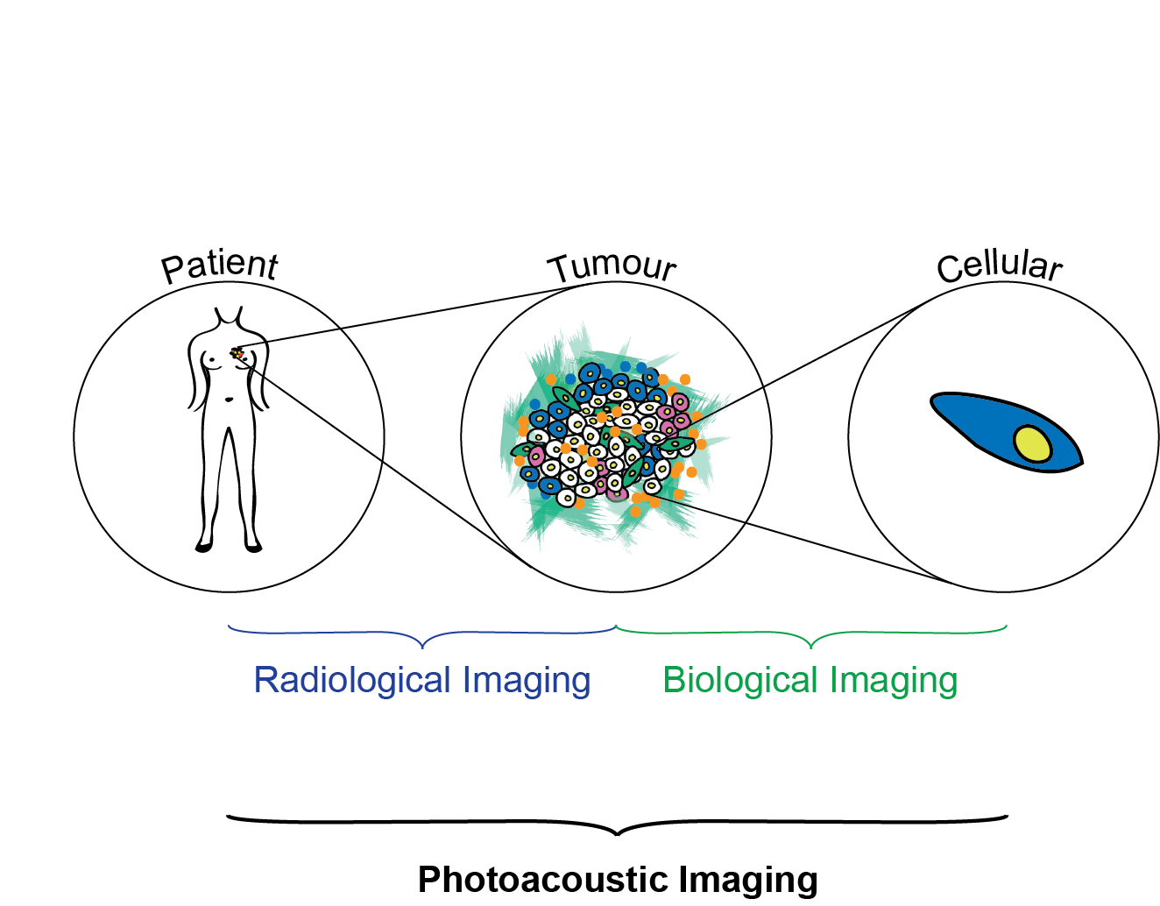

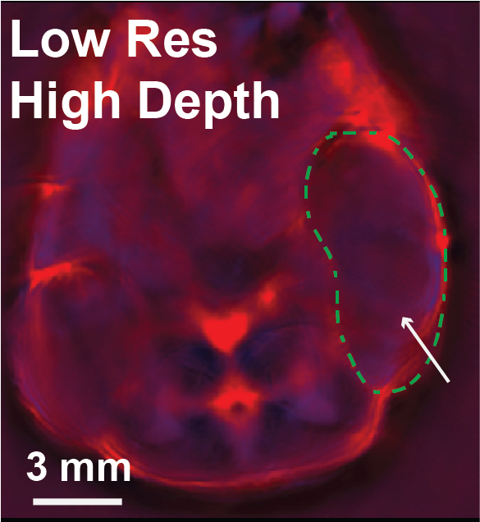
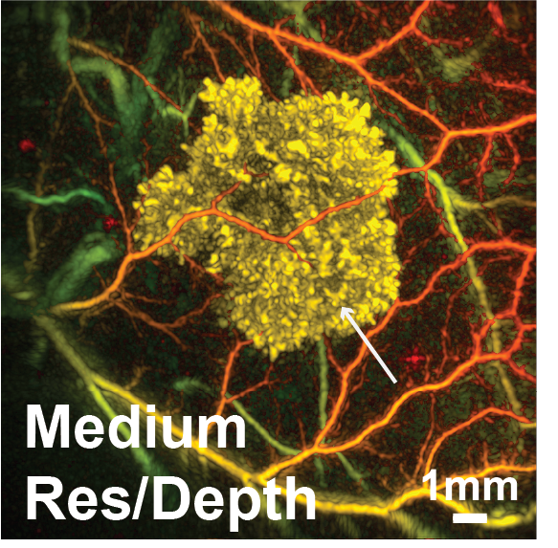
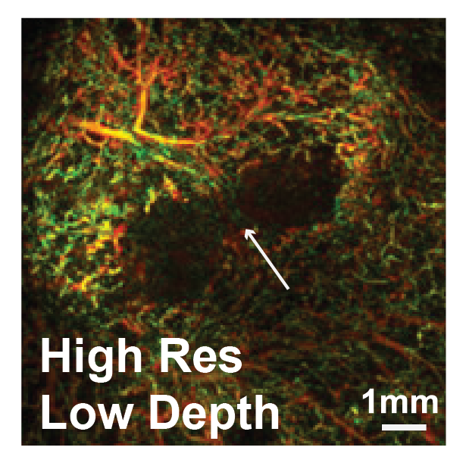
Phantom formulations must be scalable across different resolutions
Abeyakoon et al (2018) in prep; Quiros-Gonzalez et al (2018) Br J Cancer; Omar et al (2015) Neoplasia; Jathoul et al (2015) Nat Phot.

Slide 12
Phantom formulations must also be applicable across different geometries
Wang & Yao (2016) Nat Meth

Slide 13
Suggested goals of an international consortium standardisation effort
To create widely accepted phantoms for use with preclinical and clinical photoacoustic imaging systems.
To use these phantoms in quantitative comparison of photoacoustic data:
Acquired with different system designs;
Analysed with different data reconstruction / spectral processing algorithms.
To have a reference standard for new photoacoustic imaging instruments (to help with comparison of published results).
To provide open, publicly available, reference data sets for testing of data reconstruction / spectral processing algorithms.

Slide 14
Expected outcomes of an international consortium approach
Standardized recipes for background and target materials:
Proven reproducibility of the properties achieved with the recipe by independent methods and assessment across several sites;
Recipes aimed at precision evaluation and QA/QC;
Recipes aimed at accuracy evaluation.
Defined reference wavelengths and system settings to evaluate performance criteria, with suggestions for acceptance windows.
Curated open access data compiled from labs across the globe.
Ultimately, we could aim to produce a series of consensus standard open access journal publications.

Slide 15
If you would like to be involved in the proposed consortium effort, either by developing and testing materials / recipes, or imaging pre-fabricated phantoms at your Institution, please contact seb53@cam.ac.uk or see me at the end of the session.

